Slide 1



The IEEE International Conference on Robotics and Automation (IEEE ICRA 2023)
Self-Improving Safety Performance of Reinforcement Learning Based Driving with Black-Box Verification Algorithms
29 May - 2 June, 2023, ExCel London, UK Resul Dagdanov, Halil Durmus, and Nazim Kemal Ure
- Istanbul Technical University - ITU Artificial Intelligence and Data Science Research Center
- Eatron Technologies
The IEEE International Conference on Robotics and Automation (IEEE ICRA 2023)
Slide No. 1 / 24

Slide 2
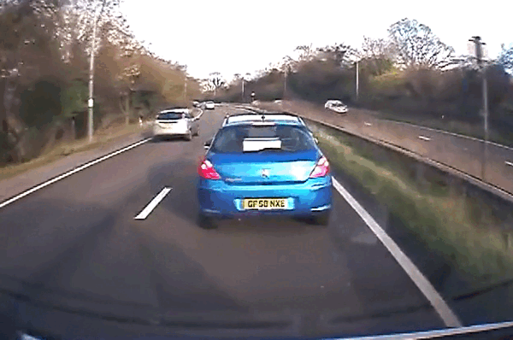
Problem Statement
Decision-making in safety-critical environment is a challenging problem.
ADAS (advanced driver assistance system) is a trend topic.
Goal is to follow the front vehicle.
Instant brakes or accelerations.
Reaction time of the drivers are low.
Scenarios:
sudden brakes
people cross the road
animals running
careless drivers
Image Credit: https://gfycat.com/chiefyearlygoat
The IEEE International Conference on Robotics and Automation (IEEE ICRA 2023)
Slide No. 2 / 24

Slide 3
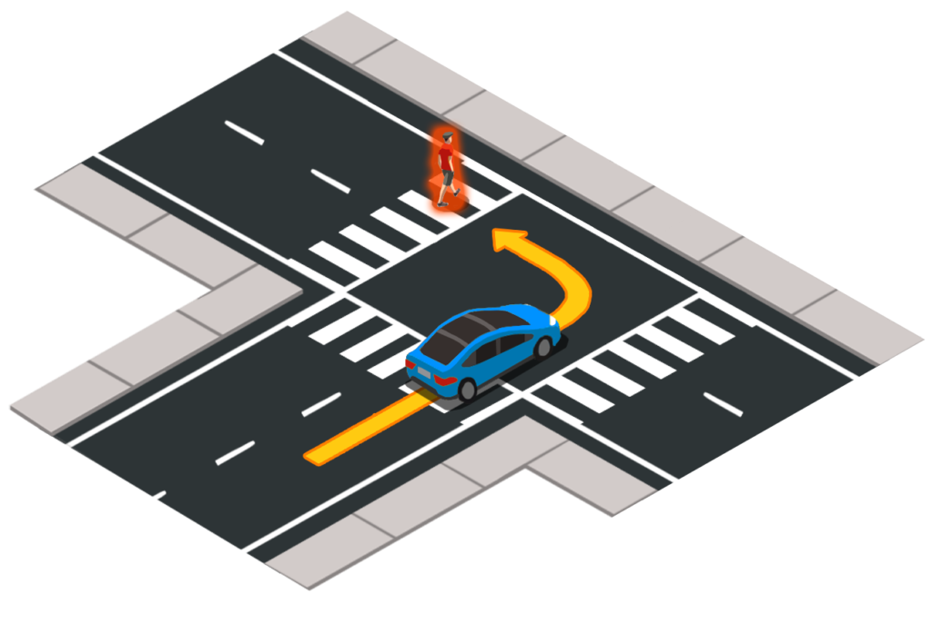
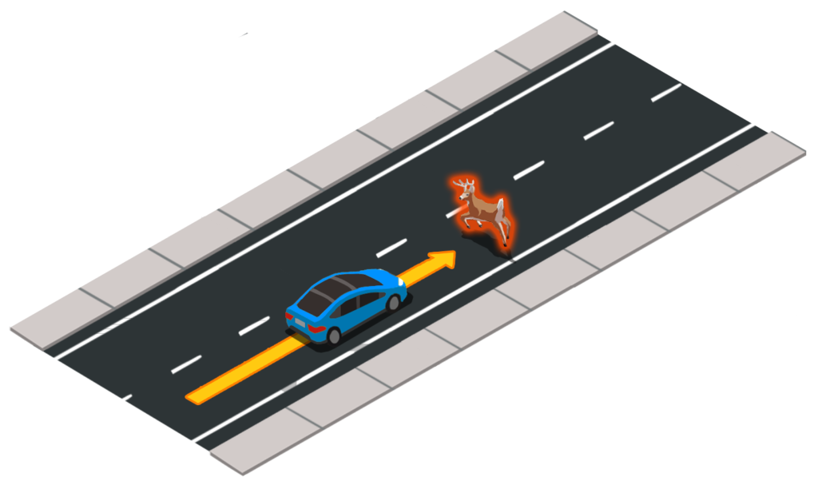
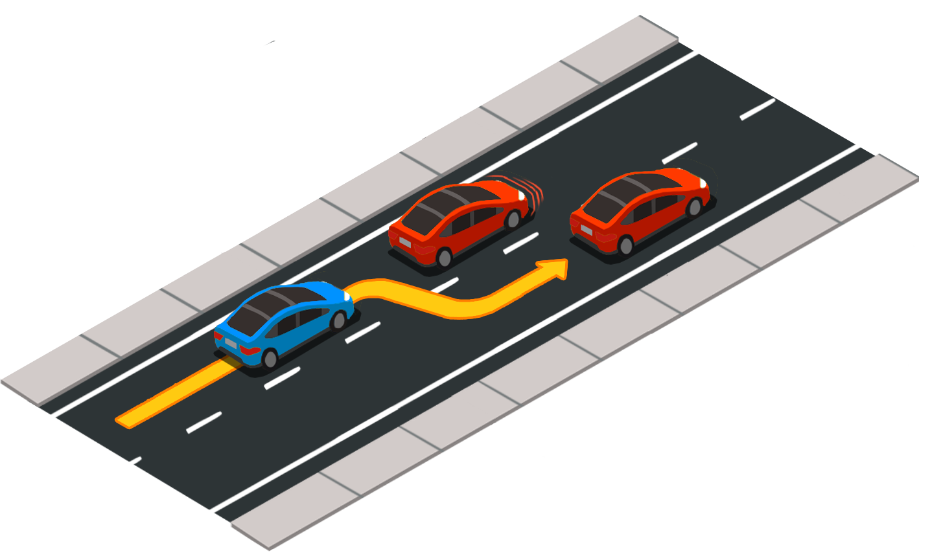
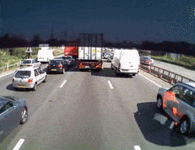
Problem Statement
Image Credits: https://carlachallenge.org/challenge/nhtsa/
Safety-critical scenarios could be generated in the simulation.
Recent works on autonomous driving systems generally focus on sensor attacks, hardware faults, and controller malfunctioning.
Everyday 3700 people die due to highway car crashes worldwide.
Computers are fast and accurate in decision making.
Safety-critical scenarios are rare-events.
Image Credit: https://gfycat.com/chiefyearlygoat
Reference: Zhou, Xugui, et al. "Strategic safety-critical attacks against an advanced driver assistance system." 2022 52nd Annual IEEE/IFIP International Conference on Dependable Systems and Networks (DSN). IEEE, 2022.
The IEEE International Conference on Robotics and Automation (IEEE ICRA 2023)
Slide No. 3 / 24

Slide 4
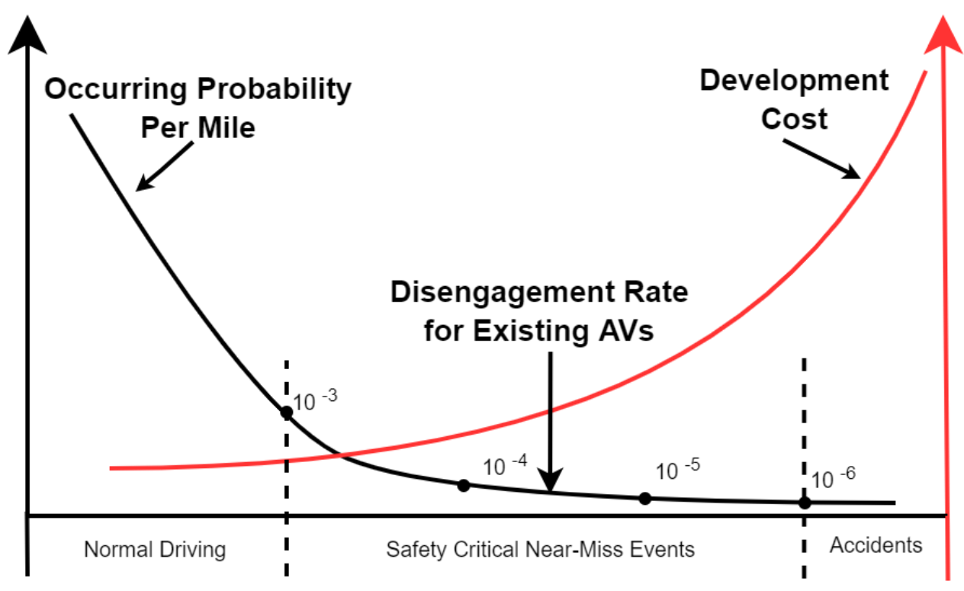
Problem Statement
Probability of observing safety-critical scenarios is very low.
The challenge lay in the observations space of events in high-dimensional environment.
Curse of dimensionality is investigated:
Numerical integration
Optimization
Machine learning
Sampling
Data mining
The amount of data needed grows exponentially with the dimensionality as probability decreases.
Reference: Liu, Henry X., and Shuo Feng. "" Curse of rarity" for autonomous vehicles." arXiv preprint arXiv:2207.02749 (2022).
The IEEE International Conference on Robotics and Automation (IEEE ICRA 2023)
Slide No. 4 / 24

Slide 5
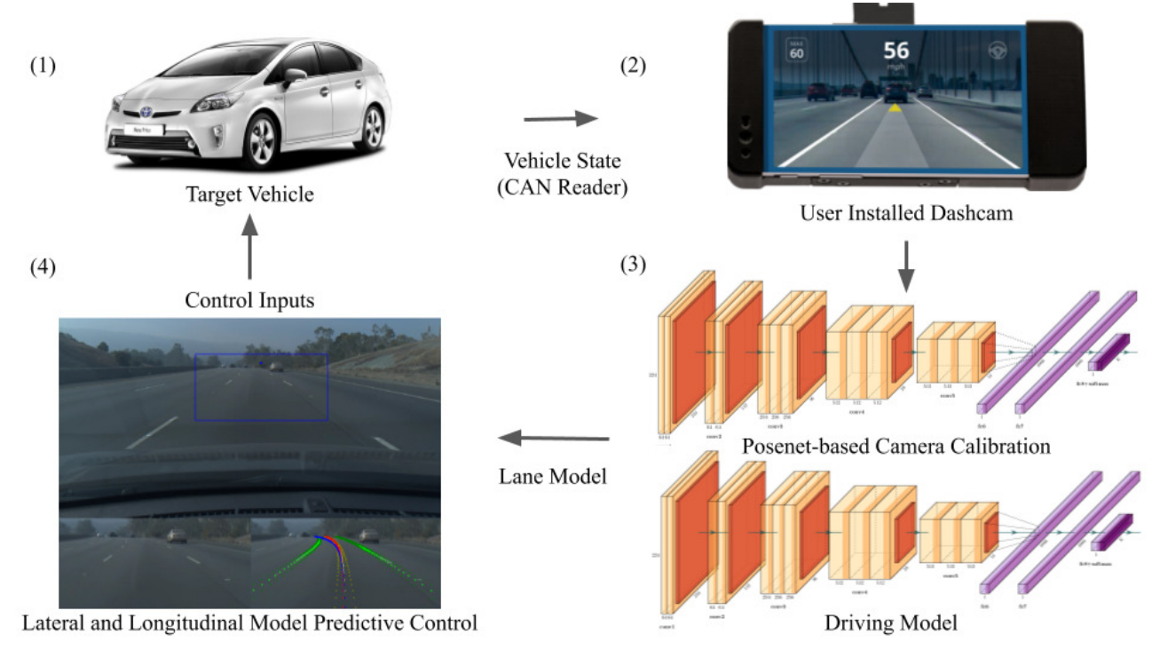
Motivation
Goal is to develop sample efficient, robust, and safe black-box system.
Propose a novel self-improving AI system.
Investigate different rare-event simulation techniques for sample efficiency.
Develop a reinforcement learning (RL) system for decision-making under safety-critical conditions.
Black-box model and RL agent are used interchangeably.
Low-level control decision-making in adaptive cruise control (ACC) applications.
Reference: Norden, Justin, Matthew O'Kelly, and Aman Sinha. "Efficient black-box assessment of autonomous vehicle safety." arXiv preprint arXiv:1912.03618 (2019).
The IEEE International Conference on Robotics and Automation (IEEE ICRA 2023)
Slide No. 5 / 24

Slide 6
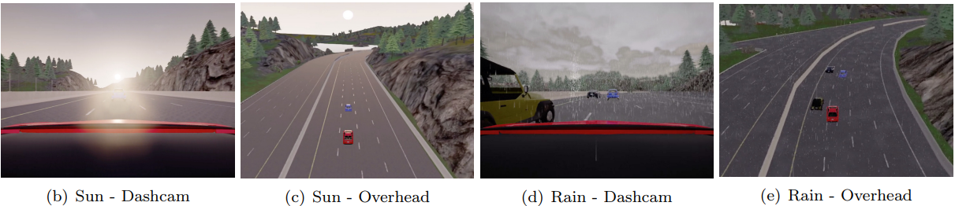
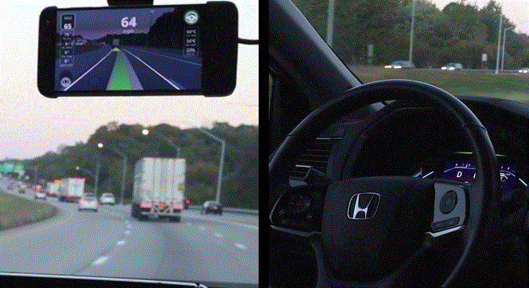
Literature Review
Generate different weather conditions in the CARLA simulation.
Use CommaAI OpenPilot as a black-box system.
Control low-level steering and acceleration motions.
Apply naive Monte-Carlo to simulate rare-event scenarios.
Implement AMS algorithm for rare-event sample efficiency.
Image Credit: https://comma-ai.medium.com/
Reference: Norden, Justin, Matthew O'Kelly, and Aman Sinha. "Efficient black-box assessment of autonomous vehicle safety." arXiv preprint arXiv:1912.03618 (2019).
The IEEE International Conference on Robotics and Automation (IEEE ICRA 2023)
Slide No. 6 / 24

Slide 7
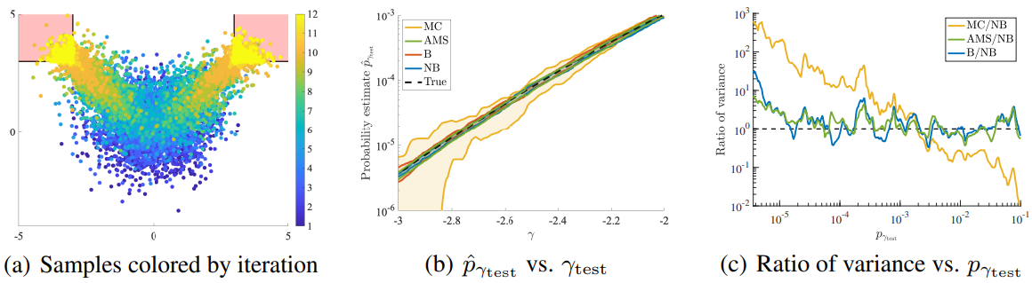
Literature Review
Goal is to efficiently evaluate complex black-box system with novel methodology.
Minimize objective function based on time-to-collision (TTC) metric.
Compare with:
Adaptive multi-level splitting (AMS)
Monte-carlo estimation (MC)
Markov chain monte carlo (MCMC)
Reference: Sinha, Aman, et al. "Neural bridge sampling for evaluating safety-critical autonomous systems." Advances in Neural Information Processing Systems 33 (2020): 6402-6416.
The IEEE International Conference on Robotics and Automation (IEEE ICRA 2023)
Slide No. 7 / 24

Slide 8
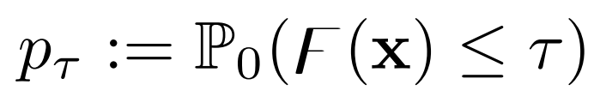
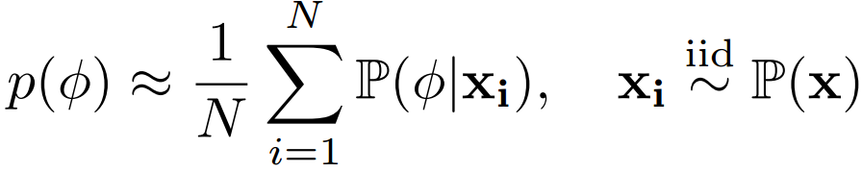
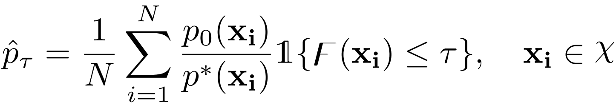
Rare-event Simulation
Without verification through rare-event simulations, the safety of black-box AD system could not be guaranteed.
Probability of the rare-event is defined by the safety function and safety metric.
Naive Monte-Carlo Sampling:
Cross-Entropy Search:
Reference: Asmussen, Søren, and Peter W. Glynn. Stochastic simulation: algorithms and analysis. Vol. 57. New York: Springer, 2007.
The IEEE International Conference on Robotics and Automation (IEEE ICRA 2023)
Slide No. 8 / 24

Slide 9
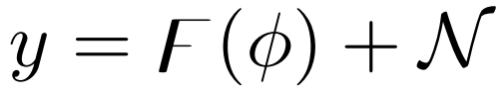
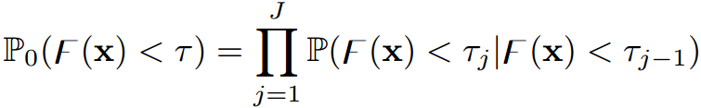
Rare-event Simulation
Bayesian Optimization:
Acquisition function is maximized in each iteration with gaussian process along with improvement function.
Adaptive Multilevel Splitting:
Safety threshold is divided into the intermediate levels.
These intermediate levels are determined by specifying a constant fraction value.
Reference: Cérou, Frédéric, and Arnaud Guyader. "Adaptive multilevel splitting for rare event analysis." Stochastic Analysis and Applications 25.2 (2007): 417-443.
The IEEE International Conference on Robotics and Automation (IEEE ICRA 2023)
Slide No. 9 / 24

Slide 10
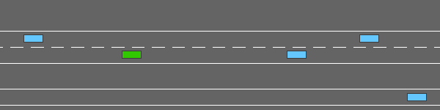
Methodology
Existing RL algorithms strongly depend on diversity of training scenarios.
Exploration and exploitation dilemma is still an open and active research area.
Lack of safety-critical scenarios in the training phase might lead to poor generalization.
Lightweight simulation environment is used. (Highway-Env)
Investigate whether the rare-event assessment and validation samples of the safety-critical system might also be utilized for automatic
self-improvement (healing) of the RL agents.
Reference: E. Leurent, “An environment for autonomous driving decisionmaking,” https://github.com/eleurent/highway-env, 2018.
The IEEE International Conference on Robotics and Automation (IEEE ICRA 2023)
Slide No. 10 / 24

Slide 11
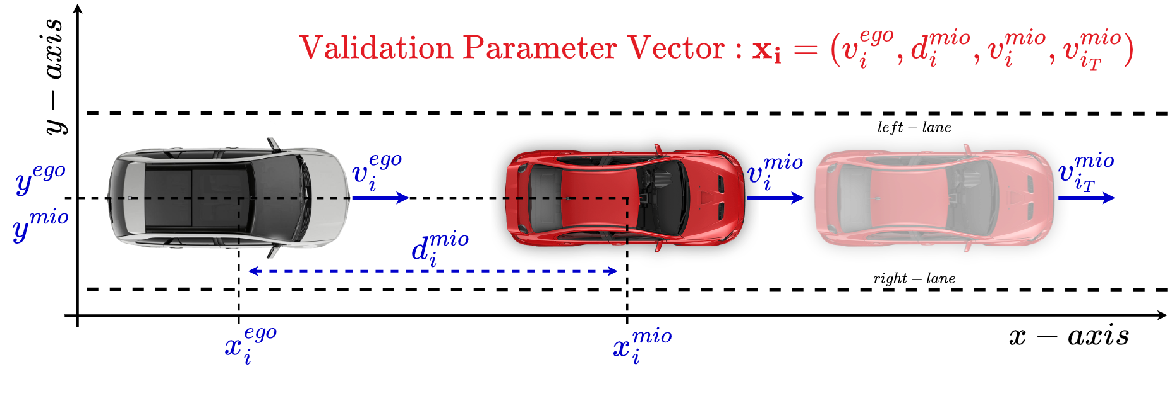
Methodology
Construction of the Optimization Parameter Vector Space:
V-ego and V-mio -> [10 m/s - 40 m/s] MIO: (Most Important Object)
D-mio -> [10 m - 120 m] EGO: (Egocentric Vehicle - Agent)
Reference: Dagdanov, Resul, Halil Durmus, and Nazim Kemal Ure. "Self-Improving Safety Performance of Reinforcement Learning Based Driving with Black-Box Verification Algorithms." (2023).
The IEEE International Conference on Robotics and Automation (IEEE ICRA 2023)
Slide No. 11 / 24

Slide 12
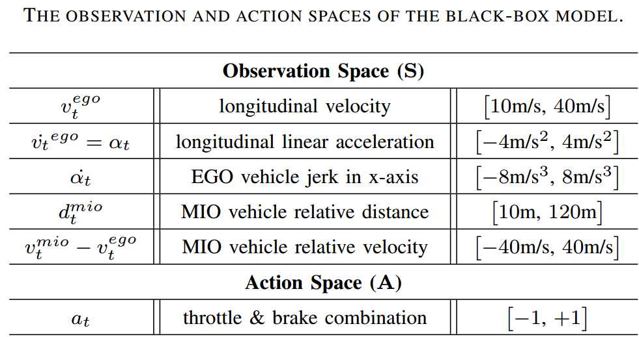
Methodology
Black-Box Model Observation and Action Space:
MIO: (Most Important Object)
EGO: (Egocentric Vehicle - Agent)
Reference: Dagdanov, Resul, Halil Durmus, and Nazim Kemal Ure. "Self-Improving Safety Performance of Reinforcement Learning Based Driving with Black-Box Verification Algorithms." (2023).
The IEEE International Conference on Robotics and Automation (IEEE ICRA 2023)
Slide No. 12 / 24

Slide 13
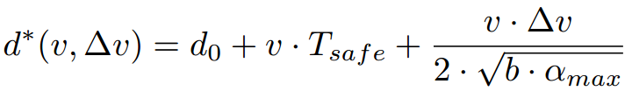
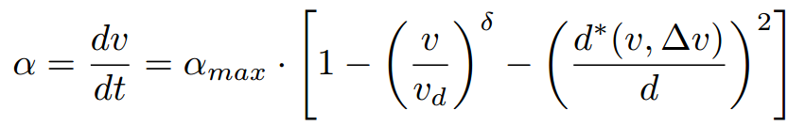
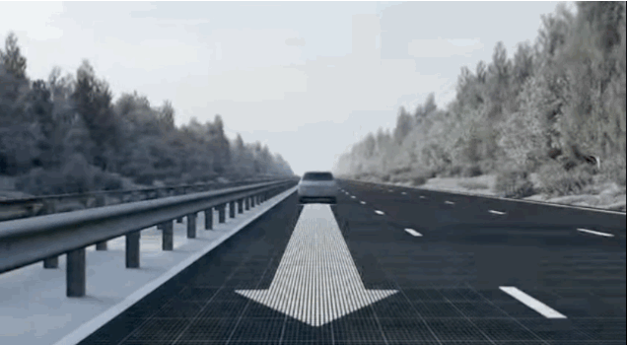
Methodology
Intelligent Driver Model (IDM):
A popular model-based method for longitudinal acceleration control.
Default (popular) simulation configuration parameters are selected in this project.
Parameters:
b: desired deceleration (-2 m/s^2)
d-0: minimum distance (3 m)
T-safe: safe headway time (1.5 s)
a-max: maximum acceleration (4 m/s^2)
delta: acceleration exponent (4)
Image Credit: https://gifer.com/en/9fjZ
Reference: Treiber, Martin, Ansgar Hennecke, and Dirk Helbing. "Congested traffic states in empirical observations and microscopic simulations." Physical review E 62.2 (2000): 1805.
The IEEE International Conference on Robotics and Automation (IEEE ICRA 2023)
Slide No. 13 / 24

Slide 14
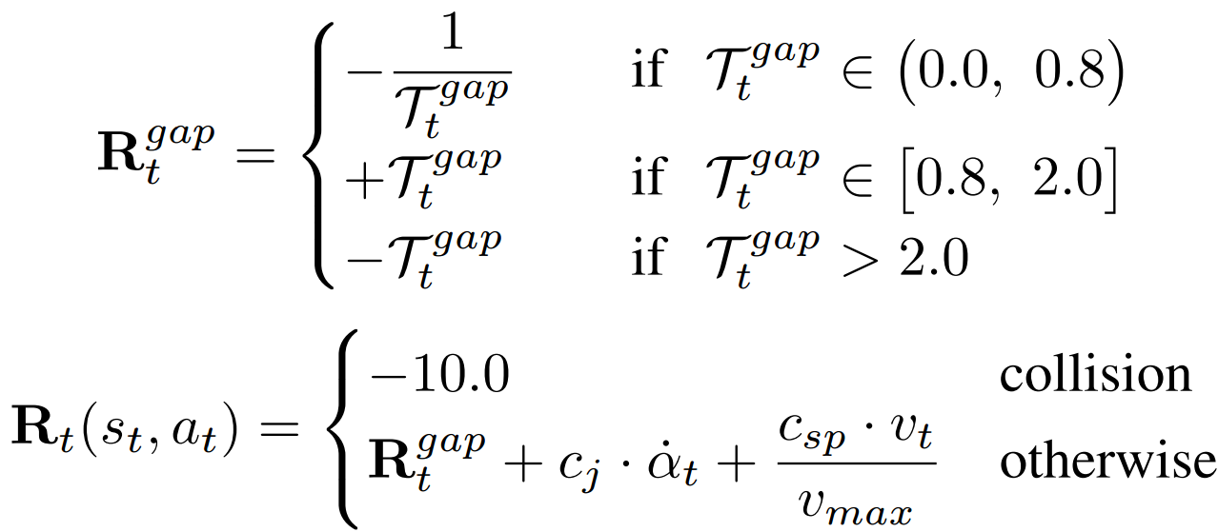
Methodology
Reward Function of RL Agent (Black-Box Model):
Vehicle following metric -> time-gap
Positive reward is given while following the front vehicle with adequate distance.
Significant penalty is given when collision occurs.
Additional penalty coefficient is given for vehicle jerk.
Parameters:
c-j: penalty coefficient for jerk (-0.5)
c-sp: 5.0
Reference: Dagdanov, Resul, Halil Durmus, and Nazim Kemal Ure. "Self-Improving Safety Performance of Reinforcement Learning Based Driving with Black-Box Verification Algorithms." (2023).
The IEEE International Conference on Robotics and Automation (IEEE ICRA 2023)
Slide No. 14 / 24

Slide 15
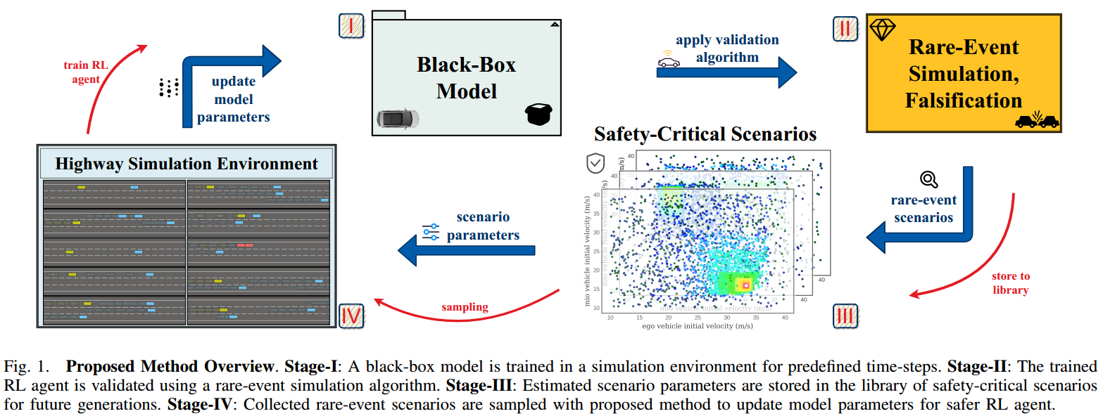
Methodology
Reference: Dagdanov, Resul, Halil Durmus, and Nazim Kemal Ure. "Self-Improving Safety Performance of Reinforcement Learning Based Driving with Black-Box Verification Algorithms." (2023).
The IEEE International Conference on Robotics and Automation (IEEE ICRA 2023)
Slide No. 15 / 24

Slide 16
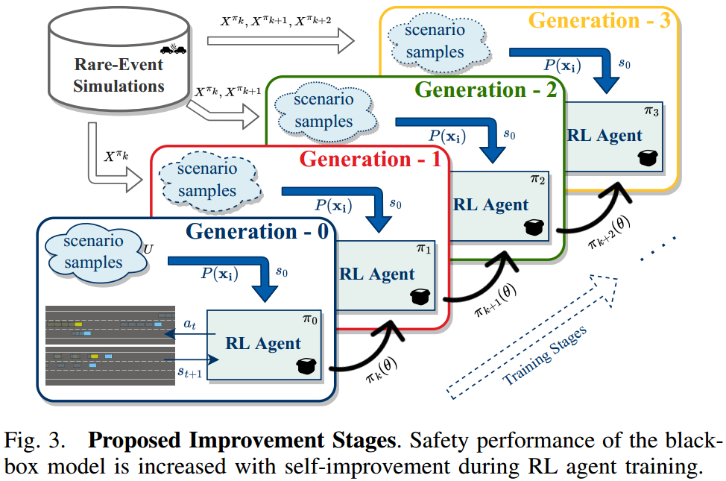
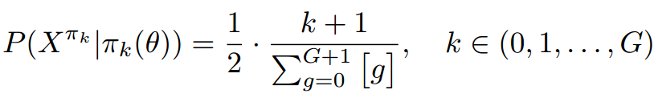
Methodology
construct a probability function.
sample from uniform distribution.
subsequent generation safety-critical scenarios are sampled with higher likelihood.
The IEEE International Conference on Robotics and Automation (IEEE ICRA 2023)
Slide No. 16 / 24

Slide 17
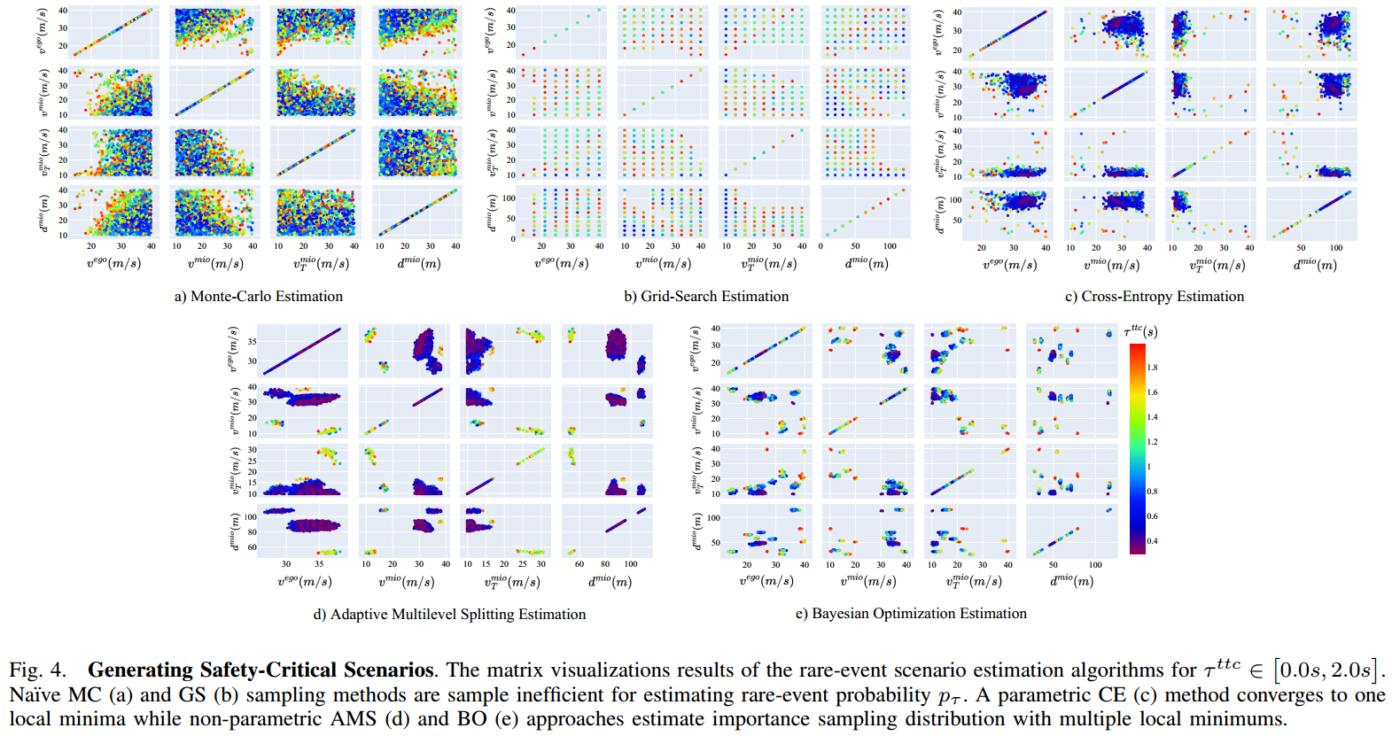
Experiments
The IEEE International Conference on Robotics and Automation (IEEE ICRA 2023)
Slide No. 17 / 24

Slide 18
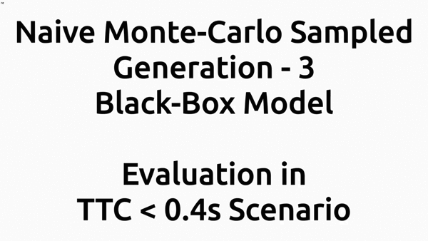
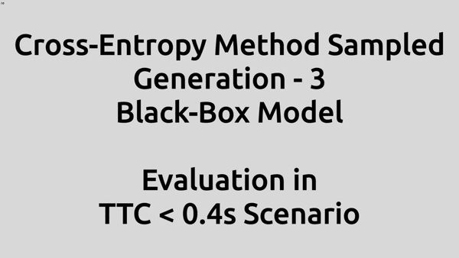
Experiments
Generation - 3 Black-Box Model Performances:
Naive Monte-Carlo Sampled RL Agent Cross-Entropy Sampled RL Agent
Reference: Dagdanov, Resul, Halil Durmus, and Nazim Kemal Ure. "Self-Improving Safety Performance of Reinforcement Learning Based Driving with Black-Box Verification Algorithms." (2023).
The IEEE International Conference on Robotics and Automation (IEEE ICRA 2023)
Slide No. 18 / 24

Slide 19
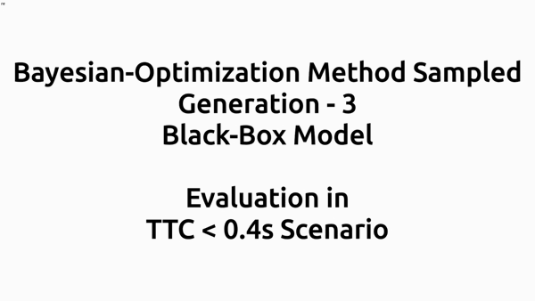
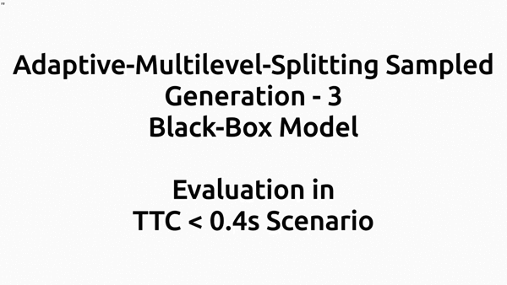
Experiments
Generation - 3 Black-Box Model Performances:
Bayesian Optimization Sampled RL Agent Adaptive Multilevel Splitting Sampled RL Agent
Reference: Dagdanov, Resul, Halil Durmus, and Nazim Kemal Ure. "Self-Improving Safety Performance of Reinforcement Learning Based Driving with Black-Box Verification Algorithms." (2023).
The IEEE International Conference on Robotics and Automation (IEEE ICRA 2023)
Slide No. 19 / 24

Slide 20
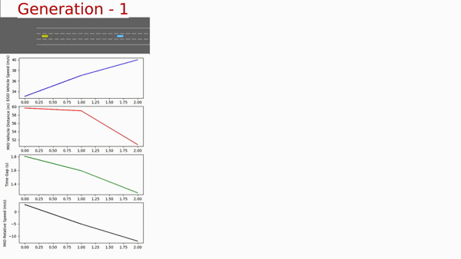
Contribution
Continuous Learning with Self-Improving Generations: (Monte-Carlo Sampled)
The IEEE International Conference on Robotics and Automation (IEEE ICRA 2023)
Slide No. 20 / 24

Slide 21
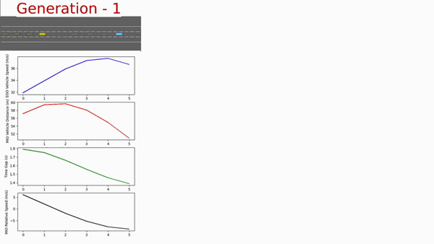
Contribution
Continuous Learning with Self-Improving Generations: (AMS Sampled RL Agent)
The IEEE International Conference on Robotics and Automation (IEEE ICRA 2023)
Slide No. 21 / 24

Slide 22
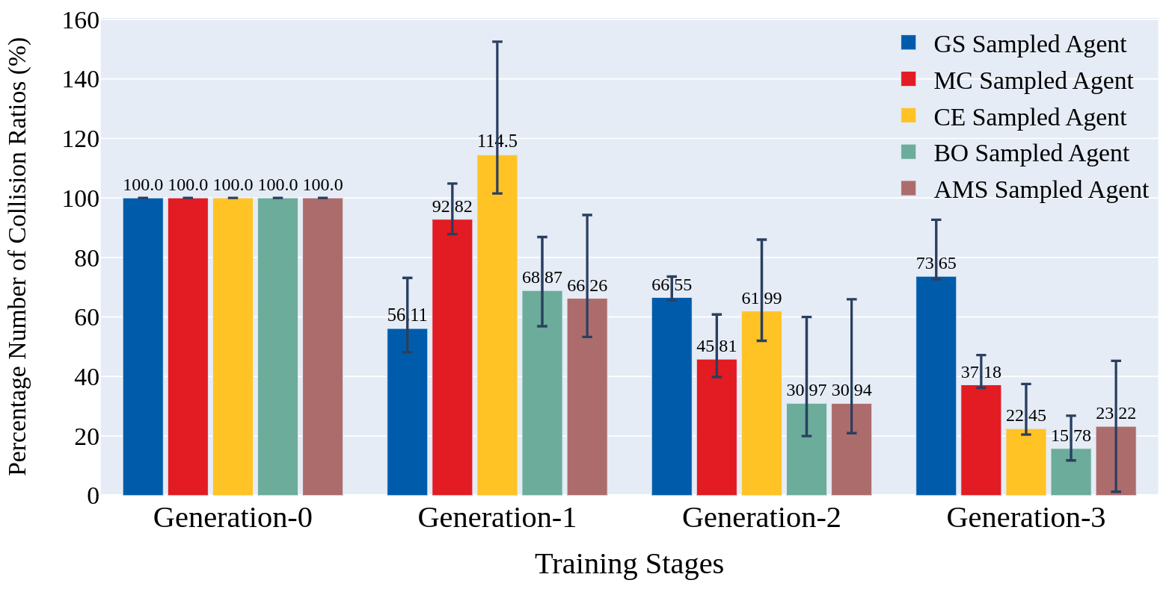
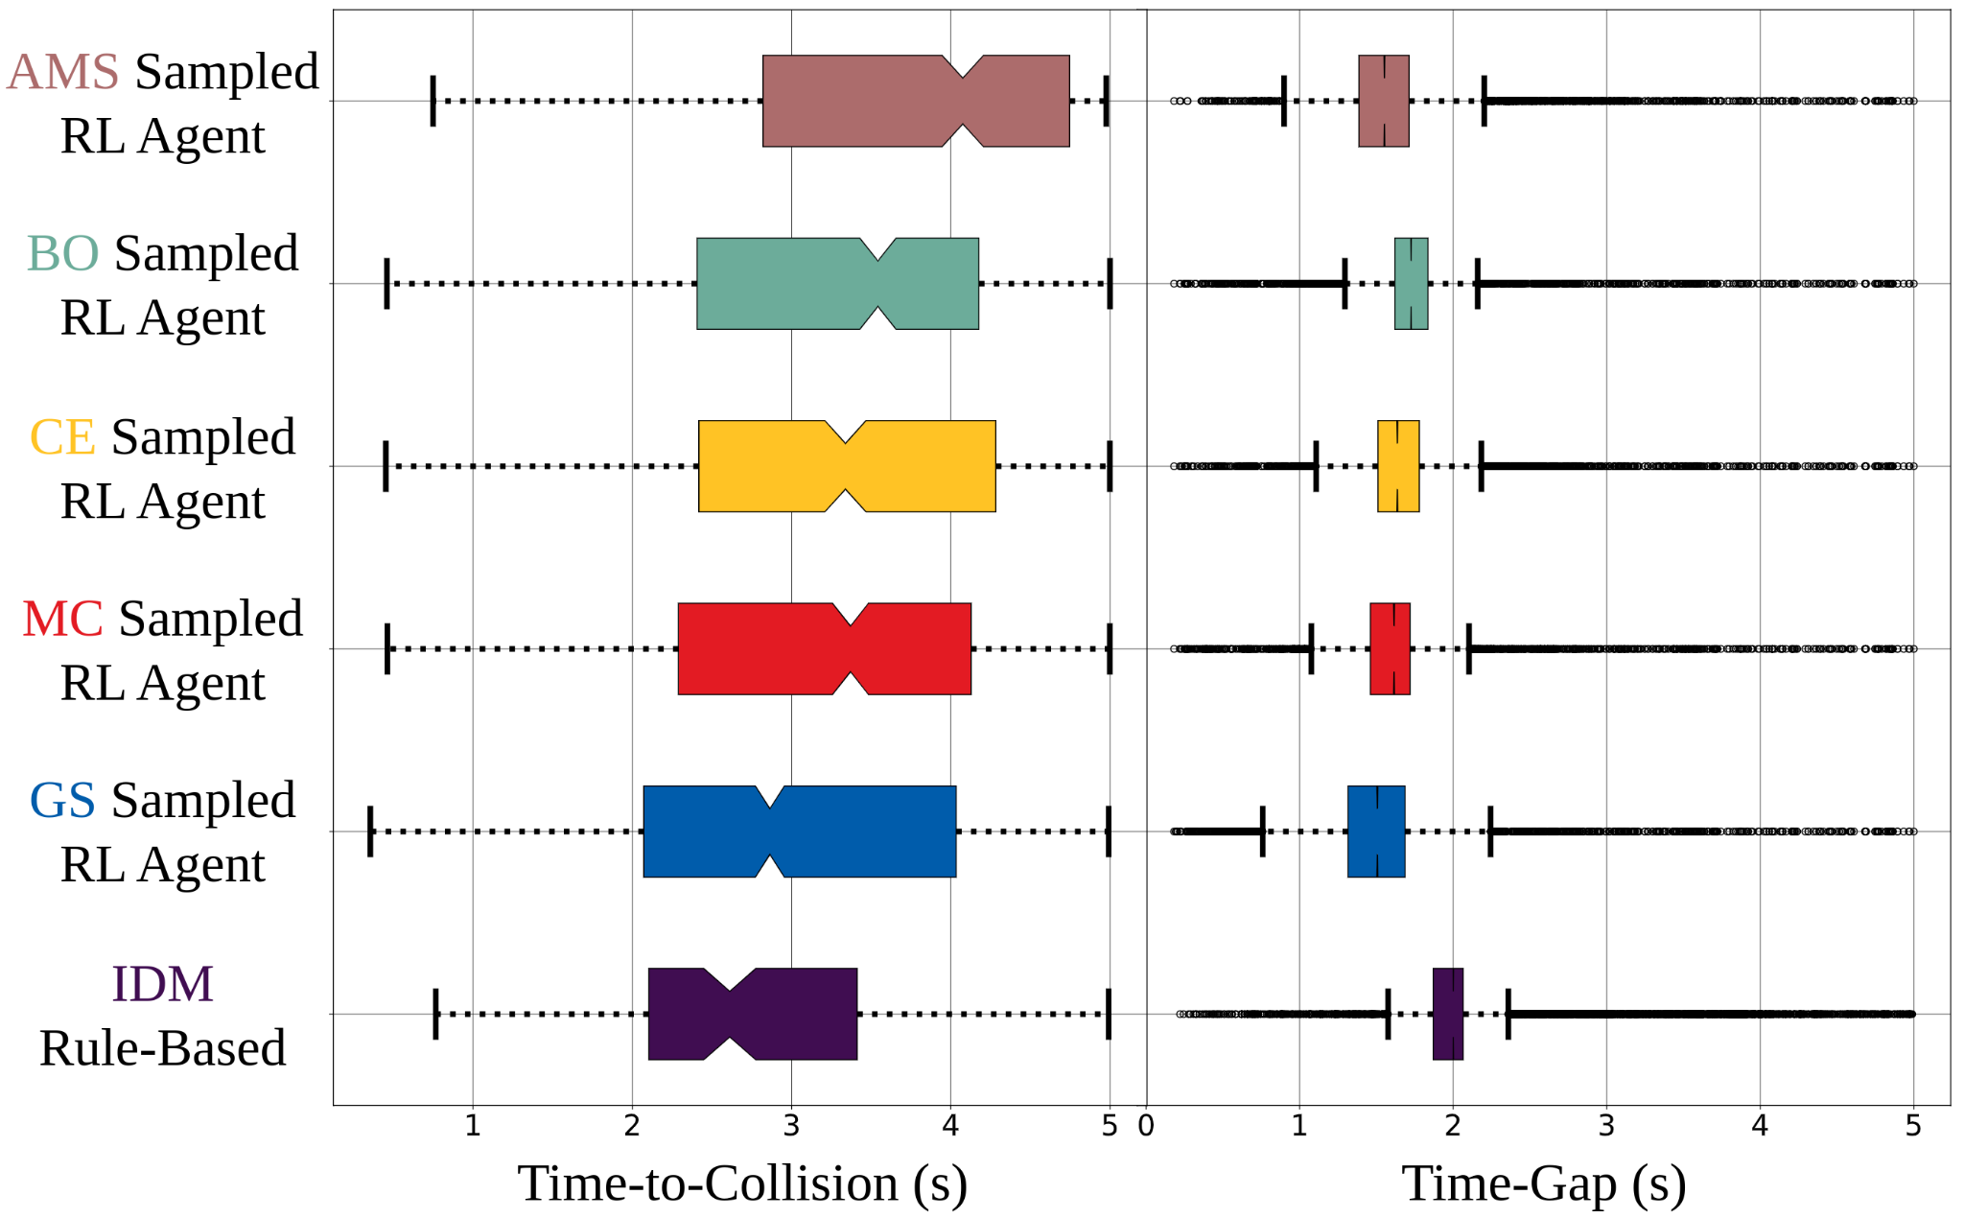
Results
Safety Performance of Differently Sampled Self-Improved Black-Box RL Agents:
Reference: Dagdanov, Resul, Halil Durmus, and Nazim Kemal Ure. "Self-Improving Safety Performance of Reinforcement Learning Based Driving with Black-Box Verification Algorithms." (2023).
The IEEE International Conference on Robotics and Automation (IEEE ICRA 2023)
Slide No. 22 / 24

Slide 23
Conclusion
Proposed a novel self-improving framework using black-box verification algorithms.
Developed a safety-enhanced reinforcement learning autonomous driving agents.
Demonstrated that the weaknesses of the exploration nature of RL agents could be inspected by leveraging rare-event simulations.
Safety-critical scenarios of the black-box model are detected in early stages of the training.
Proposed continuous learning method significantly reduces failures and vehicle collisions in ACC.
Accepted to be published at International Conference on Robotics and Automation (ICRA 2023).
The IEEE International Conference on Robotics and Automation (IEEE ICRA 2023)
Slide No. 23 / 24

Slide 24
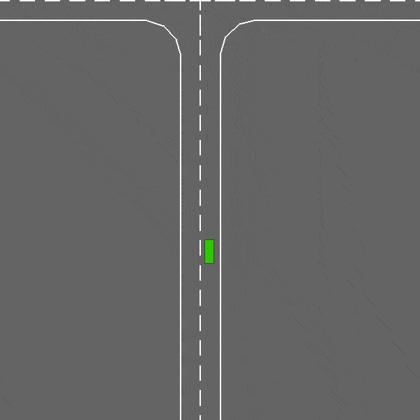
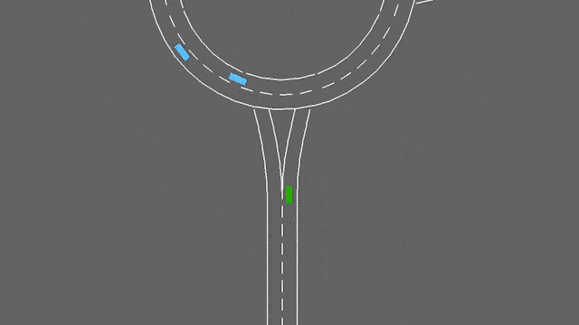
Future Work
Objective is to expand to a higher-dimensional scenario vector space.
Multiple vehicle parameters will be added to the optimization space for more general driving tasks.
Lane-changing control will be investigated within the proposed self-improving methodology.
Different sampling techniques from rare-event simulation data will be deeply examined.
Image Credits: E. Leurent, “An environment for autonomous driving decisionmaking,” https://github.com/eleurent/highway-env, 2018.
The IEEE International Conference on Robotics and Automation (IEEE ICRA 2023)
Slide No. 24 / 24

